Slide 1
Self-Training for
Jointly Learning to
Ask and Answer Questions
Advisor: Jia-lin Koh
Speaker: Yin-hsiang Liao
Source: NAACL 2018
Date: Dec11/ 2018

Slide 2
Outline
Introduction
Method
Experiment
Conclusion

Slide 3
Introduction
Question answering and question generation
QA:
well-studied problem in NLP which focus on answering questions using structured or unstructured source of knowledge.
QG:
Focusing on generating question from given knowledge.

Slide 4
Introduction
Separate tasks ➔ A joint learning task
QA:
Answering a question q based on a passage p. A sentence selection task here.
QG:
Transforming a sentence in the passage into a question

Slide 5
Outline
Introduction
Method
Experiment
Conclusion

Slide 6
Method
Overview
Train initial QA/QG model
Get Q-A pairs from unlabeled text
Update the models

Slide 7
Method
Train initial
QA/QG model
Get Q-A pairs from unlabeled text
Update the models
QA: select an answer sentence from the passage
Using two bi-LSTMs as encoders for passages and questions.
Transforming a passage to a contextual vector

Slide 8
Method
Train initial
QA/QG model
Get Q-A pairs from unlabeled text
Update the models
QA: select an answer sentence from the passage
Final answer:
Loss function:

Slide 9
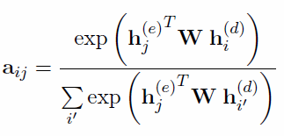
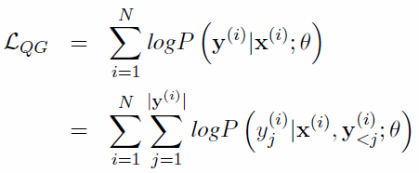
Method
Train initial
QA/QG model
Get Q-A pairs from unlabeled text
Update the models
QG: generating question from a passage
Using S2S model, a bi-LSTM as encoder and LSTM as decoder.
Effective Approaches to Attention-based Neural Machine Translation

Slide 10
Method
Train initial
QA/QG model
Get Q-A
pairs from unlabeled
text
Update the models
After training QA, QG models from labeled corpus, the QG model are used to create more questions from the unlabeled text corpus and the QA model is used to answer these questions.
Therefore, we get new Q-A pairs.

Slide 11
Method
Train initial
QA/QG model
Get Q-A
pairs from unlabeled
text
Update the models
The problem is how to selection them?
Question selection oracles introduce the most confident pairs.
Oracles are:
QG
QA
QG + QA (max min conf.)

Slide 12
Method
Train initial
QA/QG model
Get Q-A
pairs from unlabeled
text
Update the models
Curriculum learning
Easy question first, larder latter.
The challenge is how to define ‘easiness’
Here are some heuristics:
P.632

Slide 13
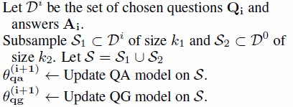
Method
Train initial
QA/QG model
Get Q-A
pairs from unlabeled
text
Update the models

Slide 14
Outline
Introduction
Method
Experiment
Conclusion

Slide 15
Experiment
Word embedding size d = 100, pretrained GloVe word embeddings.
Datasets:
SQUAD, MS MARCO, WikiQA and TrecQA.

Slide 16
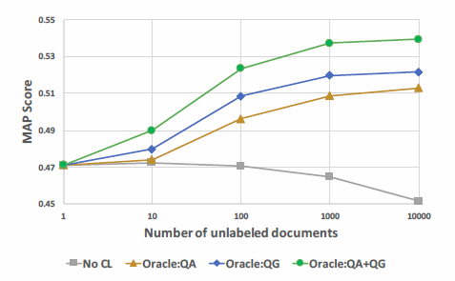
Experiment
Oracle matters for QA

Slide 17
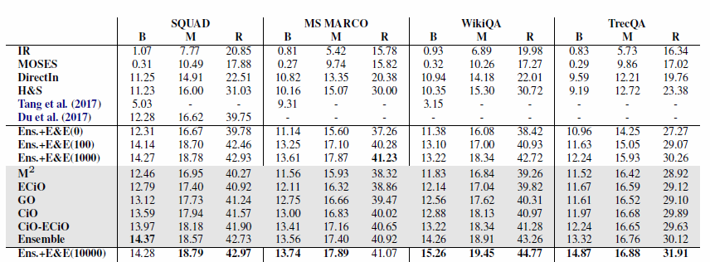
Experiment
Oracle matters for QG

Slide 18
Outline
Introduction
Method
Experiment
Conclusion

Slide 19
Conclusion
Self-training algorithm for jointly learning to answer and ask questions.
The proposed model led improvement for both QA, QG tasks.

